Slide 1


Session 3
Assess co-existing needs
CHCCCS004

Slide 2

Preparing for assessment
Using observation tools
Observation & questioning
Asking questions
Empowering questions
Strength-based approach
Self assessment activity

Slide 3
Types of assessment
Clients individual situations and needs vary greatly
Conducting assessments will therefore vary too
Who will carry out the assessment varies
Types of assessments in services:
Comprehensive assessment (initial contact)
Crisis assessment (emergencies)
Periodic assessment (changing needs)
Specialised assessment (focus on specific areas of need e.g. behaviour)

Slide 4
Purpose of assessment
Here are some examples of why you might need to conduct an assessment:
Intellectual disabilities
Physical disabilities or impairments
Drug and alcohol use
People with mental health issues

Slide 5
Sensory impairment
Sexual abuse
Homelessness
Behaviors of concern
Can you think of any other reasons for assessment ?........

Slide 6
Identify need for assessment
To determine the need for assessment consider the following:
Review any assessment letters
Check with client to ensure they agree to undergo an assessment
Interview the client about their needs
Interview family members if relevant about client needs
Observe verbal and non verbal cues and check with client you have captured all relevant information.
Consider required outcomes: Ask the following questions
What will assessment achieve?
How will outcomes affect the person?
Is the person capable of undergoing assessment?
Has assessment been recommended by another party?

Slide 7
Determine resources
Resources required could include:
Funding requirements
Expertise to carry out the assessment
Assessment tools
Location of assessment, e.g. safe location

Slide 8
All community services organisations have policies, procedures & guidelines
All services must follow
Policy
Will specify the intension for conducting assessments
Procedure & Guidelines
Will specify how to determine whether an assessment is required.

Slide 9
Using a strength- based assessment
Community services operate from a strength-based service delivery model
Strength based focuses on a person’s strengths and competencies
See’s the client as capable
See’s the client as having potential
Focuses on resources the client already has access to
Builds on individual strengths
In contrast:
Problem focused, limits the clients potential, emphasises on diagnosis, emphasis on limitations, attention is on what’s not functioning with client, discourages the client, can develop further dependencies.

Slide 10
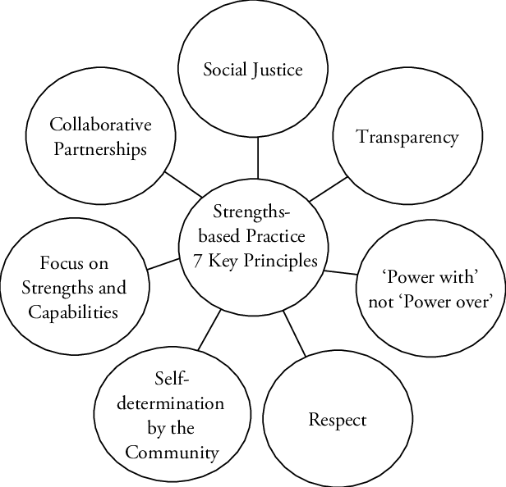

Slide 11
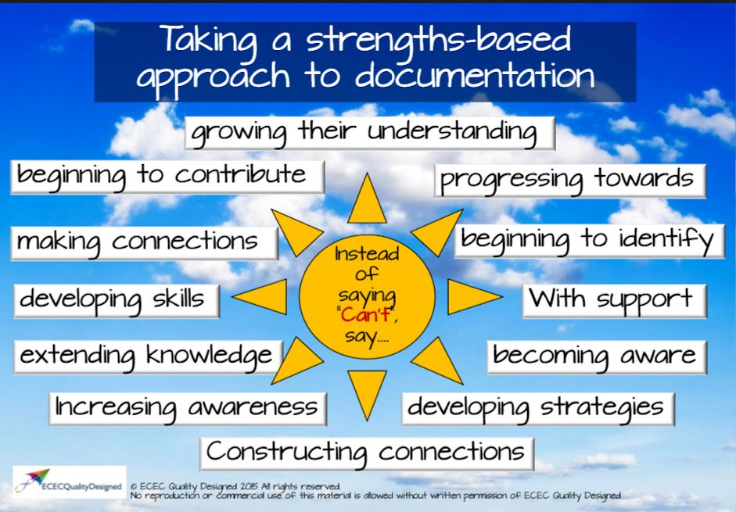

Slide 12

What is the strength based approach ?
YouTube : https://www.youtube.com/watch?v=BALni0nEmGM#action=share

Slide 13
Advantages of the strength-based perspective
Empowers the client
Doesn’t victimize
Focuses on clients resources
Limits stigmatizing language
Gives client a sense of ownership of their situation
Enhances participation
Encourages clients to identify their own strengths and resources
Gives clients a sense of hope
Encourages clients

Slide 14

Case study
Andrew* was a year 9 student when he was referred to Reconnect.
His parents separated when he was young which impacted on his engagement at school. Andrew struggled to make positive friendships and was often targeted by other students, which was effecting his self-confidence.
Andrew was provided with practical and emotional support at school each week as well as new strategies to help him communicate with his parents, teachers and students. Andrew took part in individual and group activities outside of school, such as walks, bike riding and ten-pin bowling, to help build his confidence in social settings.
Support was also provided to both his parents in having open discussions with Andrew about his progress at school and to assist his parents to form better relationships with Andrew’s school.
As a result, Andrew’s relationships with his parents improved and he continued to live with both parents alternatively. Andrew’s self-confidence improved dramatically, he established positive friendships and approached his youth worker to inform him that he was happy and felt that he no longer required support.
Feedback from the school guidance officer was that Andrew’s engagement has noticeably improved.

Slide 15
Example assessment tools
AOD intake form
AOD comprehensive assessment tool
Strengths tool
Goals tools
Mental health tool
Client consent tool
Child family wellbeing
Wellbeing assessment plan guide

Slide 16

Assessment task 1.
Interview with client 1 (Jim)
Working in pairs
Break out room discussion

